Slide 1
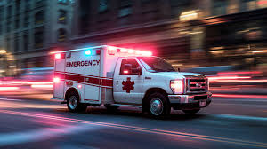
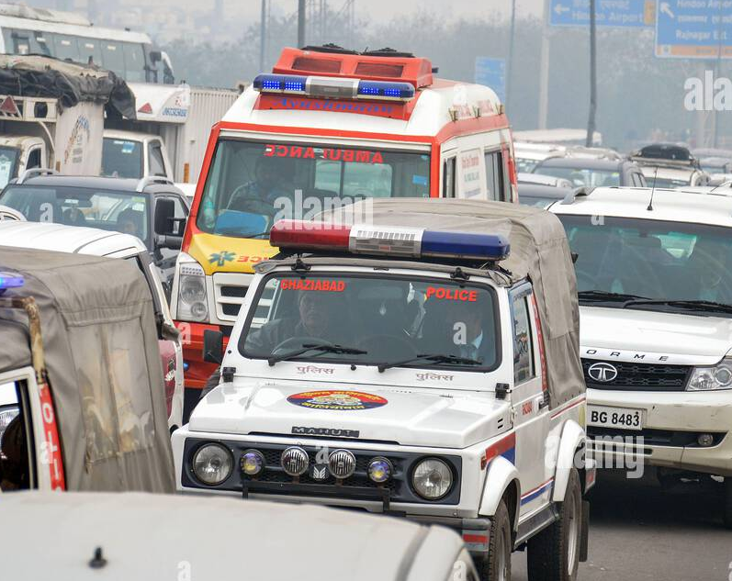
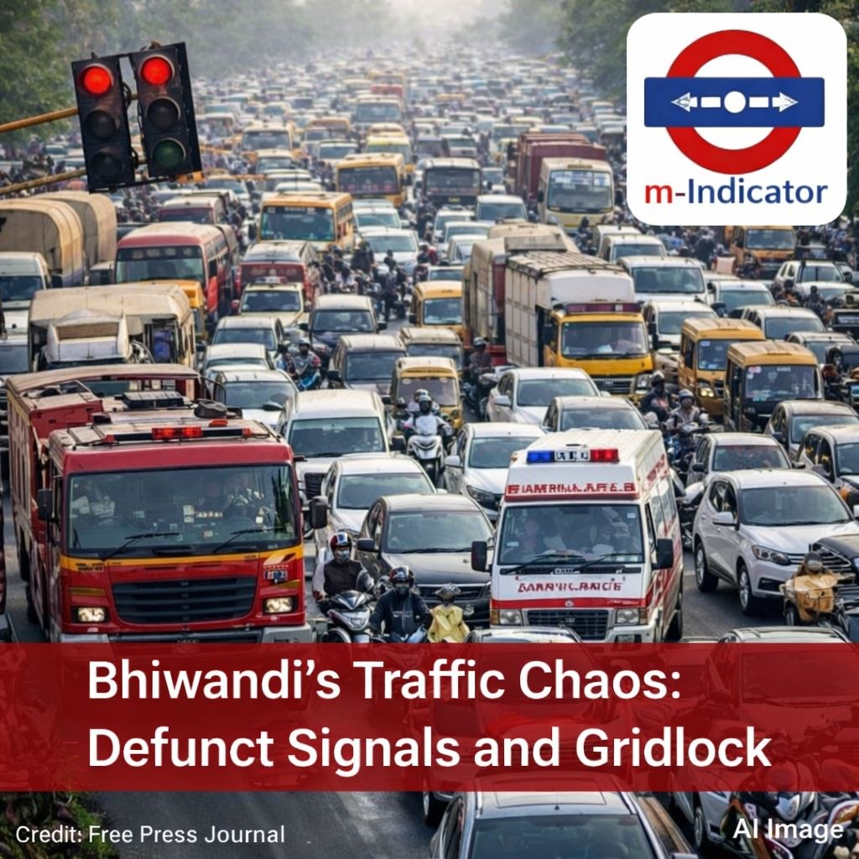
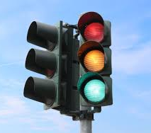
SMART GREEN CORRIDOR SYSTEM
for Emergency Vehicles Using IOT
TEAM MEMBER:-
Aman kr. Yadav
Aman Raj
Rahul kr. Bharti
Nilakshi Bhagat
Jasnoor
PRESENTED BY :- CODE BREAKERS

Slide 2
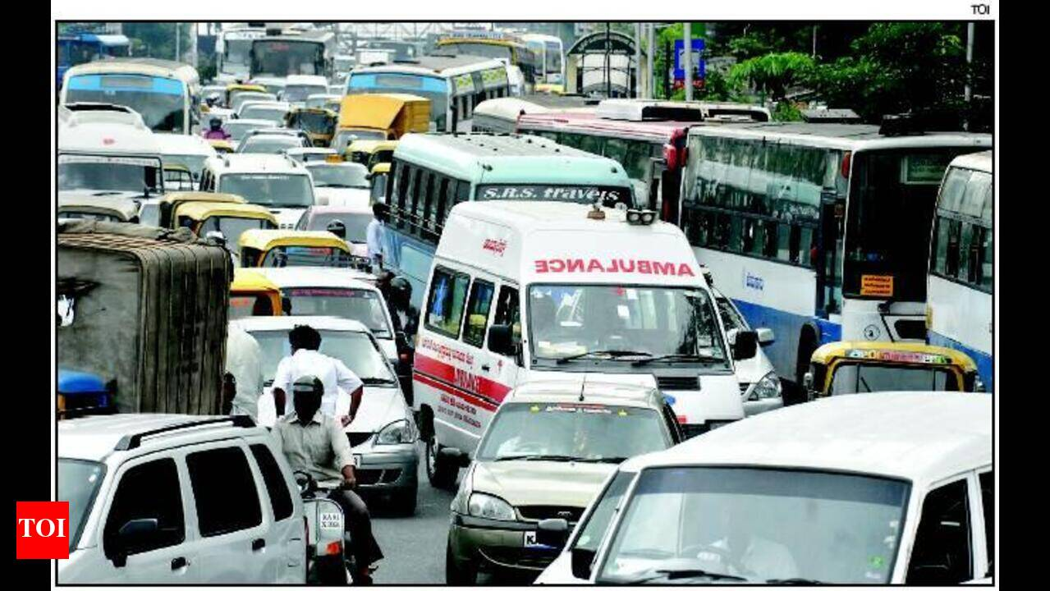
INTRODUCTION
Delay in emergency vehicles due to high traffic causes :-
Death of approx 20,000 to 25,000 people every day.
Same happens With to fire fighting trucks and other emergency vehicles.
Causing loss of human lives & losses of property.
This system provides a smarter way to resolve this problem where every
second delay can cost a life.

Slide 3
OUR VISION
To design a real-time traffic control system that prioritizes
emergency vehicles.
To detect emergency vehicles using IOT technology and
provide a clear path (green corridor) .
To create a system that do not depend on Internet.
To develop a system that supports all types of emergency
vehicles such as ambulance, fire brigade, police, special VIP
convoys, etc.
To implement a smart, scalable solution for future smart city
infrastructure without changing the present infrastructure.

Slide 4
How the System Works
A smart IoT device is installed inside emergency vehicles acts as Transmitter.
This device sends a wireless signal using a personal WiFi network.
Another IoT unit is placed at the traffic signal which acts as Reciever.
When the emergency vehicle enters within a specific area of IoT devices
(Vehicle – Traffic Lights) the driver will identifies the lane & send a
request/control signal.
Immediately, the corresponding traffic signal turns GREEN & other lanes will
turn to RED.
Vehicles in other lanes automatically stop on their left side.
A clear path is created, allowing the emergency vehicle to pass smoothly.
After crossing, the system resets to normal operation.

Slide 5
System Concept
Device Setup
The system consists of two devices: a Sender and a Receiver .
The Sender device is installed inside the emergency vehicle .
The Receiver device is installed at the traffic signal or control
room
MAC Address Communication
Each sender device has a unique MAC address .
For communication, the receiver must know the sender’s MAC
address.
This ensures secure and accurate connection between devices.
Control Room Coordination
When an emergency vehicle needs to pass, the driver informs the control room
The driver shares:
1. Vehicle’s MAC address
2. Current lane/route number
The control room forwards this information to the respective traffic signal system

Slide 6
Detection and Signal Activation
The system verifies the MAC address
The corresponding lane signal turns GREEN
All other lanes turn RED
Traffic Clearance
Vehicles in other lanes automatically stop .
Drivers move to the left side, creating a clear path .
The emergency vehicle passes smoothly without delay .
System Reset
Once the emergency vehicle crosses the signal and exits the 200-meter range all the connections lost .
The system automatically resets.
Normal traffic operation resumes

Slide 7
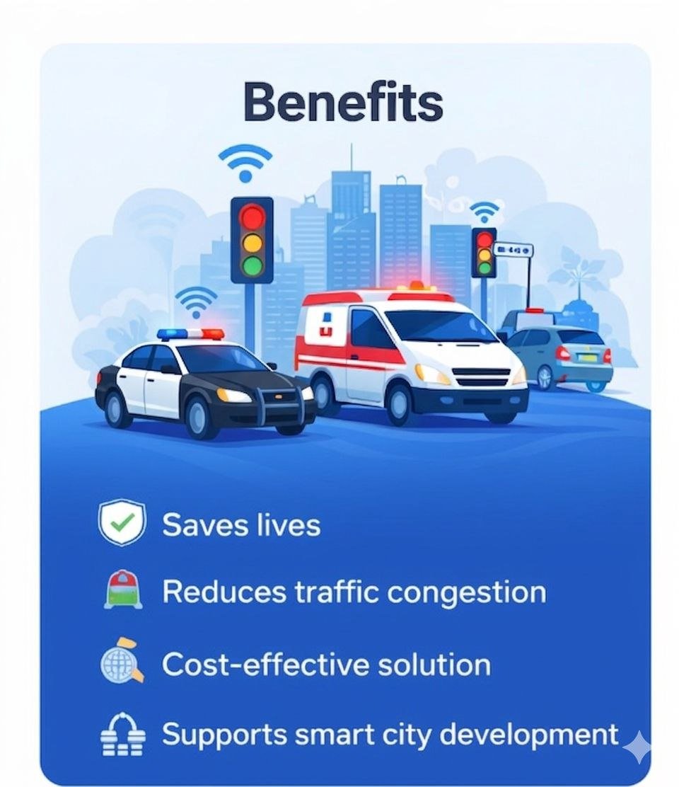
BENEFITS
This system saves human lives and property.
This solution can be applied without changing the present infrastructure.
Cost-effective solution.
Supports smart city development.
Reduces traffic congestion.

Slide 8
THANK YOU

